Slide 1
A Different Way of Looking at Franciscan Servant Leadership
National Fraternity Chapter
October 2014
Anne H. Mulqueen, ofs
[Franciscan Leader]

Slide 2
Tools
Scripture
Official Documents of the OFS
Servant Leadership Manual
NAFRA and CIOFS Websites
NEC and Other Regional Ministers
Long, long, long list of Leadership Books

Slide 3
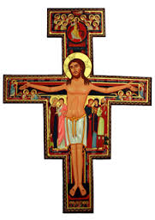
The Essence of Franciscan Spiritual Leadership
Most High, Glorious God!
(1) enlighten the darkness
of my heart,
(2) give me right faith,
(3) certain hope, and
(4) perfect charity,
(5) wisdom and
(6) understanding, Lord,
(7) that I may carry out
your holy and true command.

Slide 4
Enlighten my Darkness: Trait 1 of a Franciscan Spiritual Leader
Most High, Glorious God,
Give me zeal
for
moral fortitude
and
righteousness

Slide 5
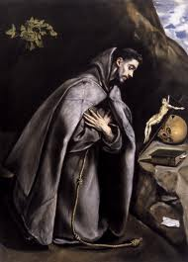
FOLLOWING FRANCIS
enlighten the darkness of
my heart
"When a man envies his brother [or sister] the good that God says or does through him, it is like committing a sin of blasphemy,
because he is really envying God, who is the only source of every good."
(Admon. 8 St. Francis of Assisi)

Slide 6
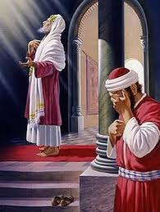
LISTENING TO JESUS
Short version of the Pharisee and the Tax Collector
A Pharisee and a tax collector went to the temple area to pray.
The Pharisee prayed, thanking God that he was not like the rest of humanity—greedy, dishonest, adulterous—or even like this tax collector. The Pharisee fasts and tithes.
But the tax collector—at a distance with his eyes lowered prayed:
“O God, be merciful to me a sinner.”
Who went home justified? Jesus said:
“ …everyone who exalts himself will be humbled, and the one who humbles himself will be exalted
Luke 18:9-14

Slide 7
(Quote from Teal Swan) TAKE AWAY (1)

Slide 8
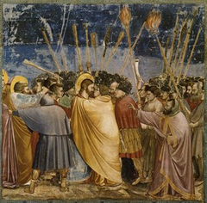
TAKE AWAY (2)
enlighten my darkness
We should be careful not to over-estimate our personal righteousness
substance rather than image is the path to the heart of God.
Who we are—too often—determines how we perceive others’ actions and sometimes with disastrous results.
The Kiss of Judas

Slide 9
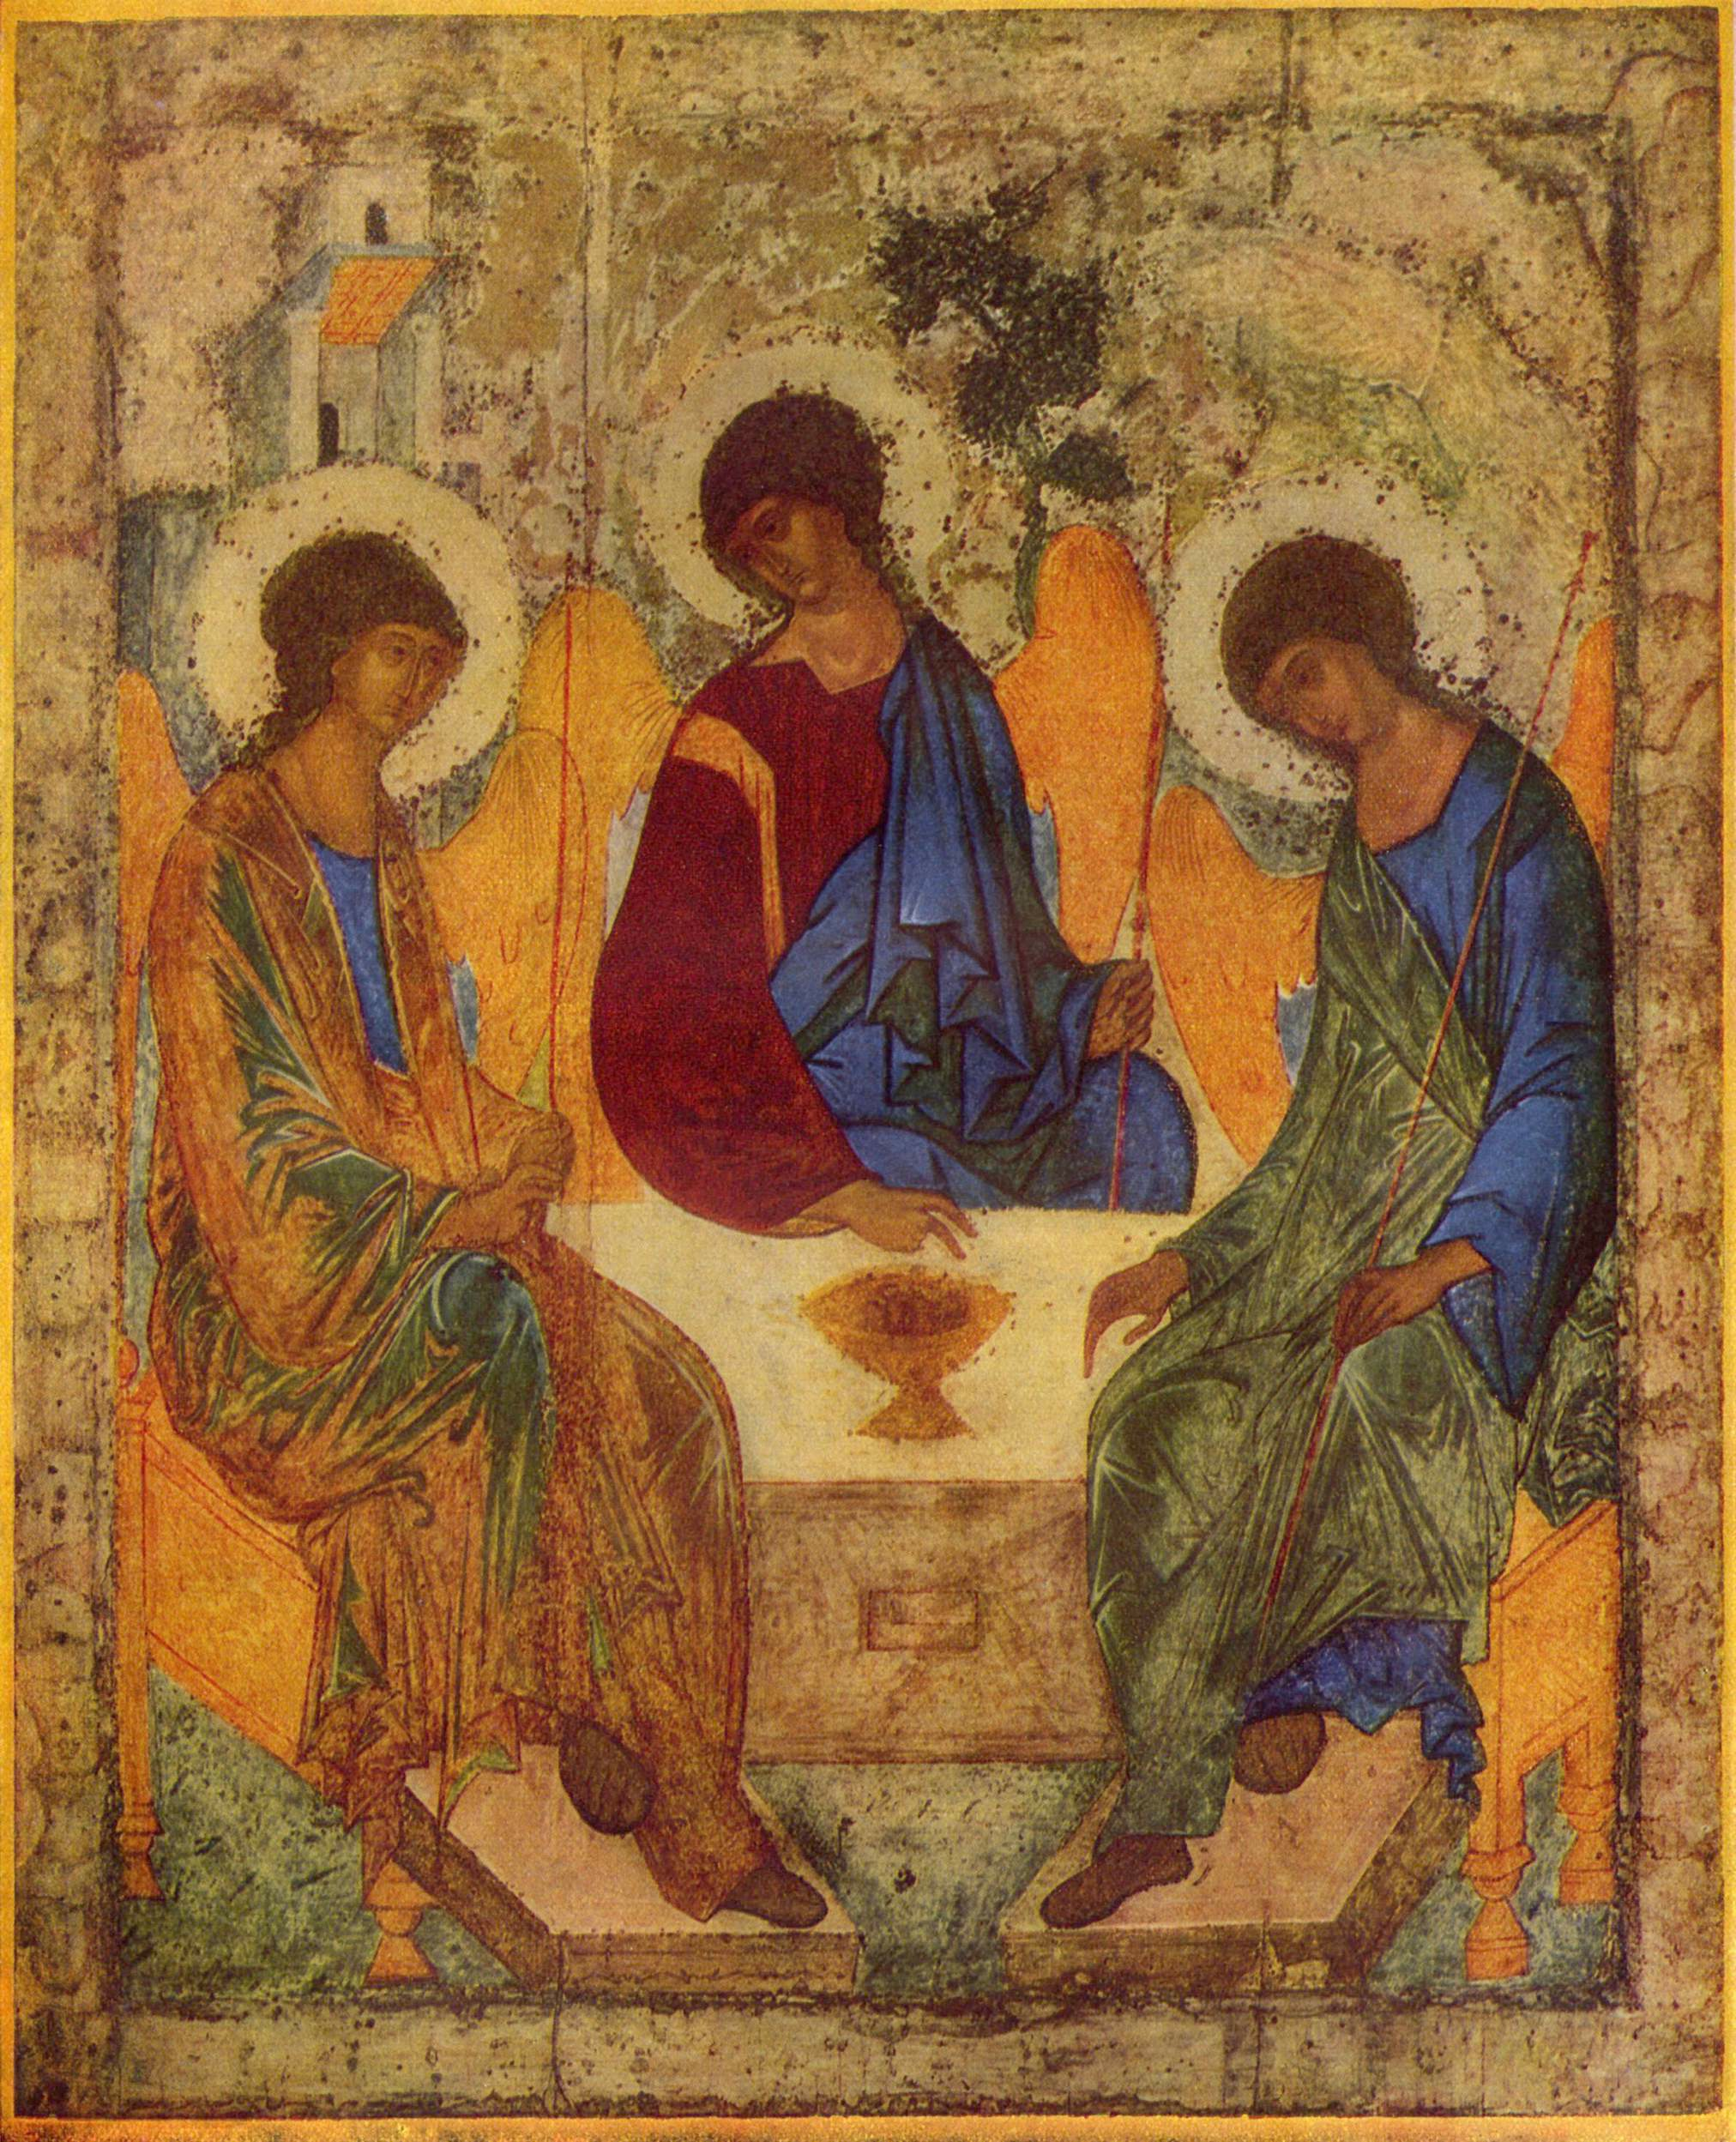
Right Faith: Trait 2 of a Franciscan Spiritual Leader
Most High, Glorious God!
Help me develop a deeper understanding of Jesus through his message of faith and salvation and how to apply faith in my capacity as a Franciscan Servant Leader.

Slide 10
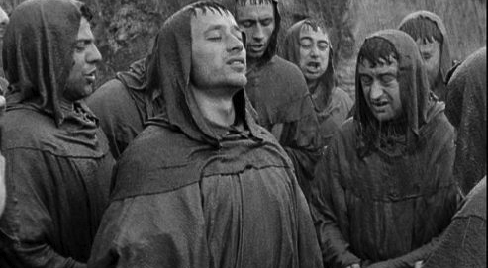
FAITHFULLY FOLLOWING FRANCIS
And the Lord gave me such FAITH … that I would pray with simplicity in this way and say: We adore You, Lord Jesus Christ
—in all Your churches throughout the whole world— and we bless You
because by Your holy cross, You have redeemed the world.
[the emphasis is on Christ]
The Testament 4-5

Slide 11
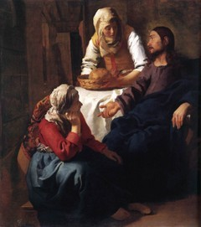
PLACING MY FAITH IN JESUS
Jesus consoling Martha and Mary on the death of Lazarus—
Jesus told [them], “I am the resurrection and the life; whoever believes in me, even if he dies, will live, and everyone who lives and believes in me will never die.
Do you believe this?” [Do you have faith in me?] [Martha] said to him,
“Yes, Lord. I have come to believe that you are the Messiah, the Son of God, the one who is coming into the world.”
John 11:25-27

Slide 12
TAKE AWAY
give me right faith
Faith is a supernatural gift that invites us into the hidden mysteries of God’s own divine life.
Faith assures us salvation John 6:47
Faith will heal us [at least spiritually] Mark 10:52
Faith paves the way to forgiveness of sin. Mark 2:5
Faith extends beyond Christ—to the Christ in others—we must have faith in others to do what they have been called to do.

Slide 13
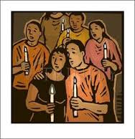
Certain Hope: Trait 3 of a Franciscan Spiritual Leader
Most High, Glorious God!
Help us to persevere in HOPE believing you will always provide all that we need to form us into wise and loving Christian Franciscan Leaders.
3

Slide 14
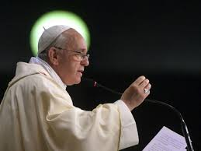
FOLLOWING POPE FRANCIS
All Saints Day Homily
“The feasts of All Saints and All Souls are ‘days of hope,’ Pope Francis said. The virtue of ‘hope is like a bit of leaven that enlarges your soul. There are difficult moments in life, but with hope you go forward and keep your eyes on what awaits us.
Today is a day of hope; our brothers and sisters [the saints] are in the presence of God, and we, too, will be there in the Lord's arms if we follow the path of Jesus."
St. Paul tells us that HOPE has a name. Hope is Christ.

Slide 15
PLACING OUR HOPE IN JESUS
Hebrews 11:1 Now faith is the assurance of things HOPED for, the conviction of
things not seen.
For in this HOPE we were saved. Hope that IS seen is NOT hope.
For who hopes for what he sees?
But if we hope for what we do NOT see, we wait for it with patience.
Romans 8:24-25

Slide 16
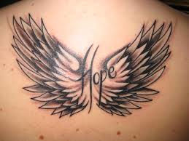
TAKE AWAY
Hope is a life force that keeps us going.
Hope helps us to deal with life’s problems.
Lack of hope can lead to burnout:
Shirking responsibilities
Becoming exhausted and overwhelmed
Becoming negative and cynical
Hope is the thing with feathers--
But those who hope in the LORD will renew their strength. They will soar on wings like eagles; they will run and not grow weary, they will walk and not be faint.
Isaiah 40:31
That perches in the soul –

Slide 17
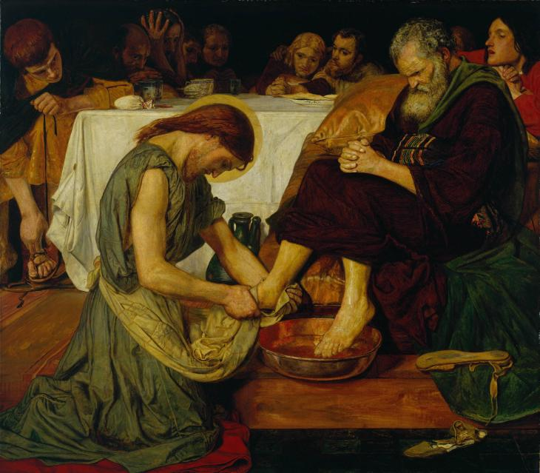
Perfect Charity: Trait 4 of a Franciscan Spiritual Leader
Most High,
Glorious God!
Infuse every inch of my being with fraternal love
Jesus Washes the Disciples’ Feet

Slide 18
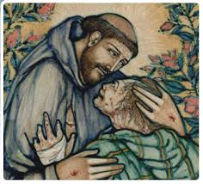
FOLLOWING FRANCIS in prfect charity:
The Beginning of Francis’ Life of Penance and Love
… for when I was in sin, it seemed too bitter for me
to see lepers.---
And the Lord Himself led me among them. ---
And I showed mercy [perfect charity] to them ---
and when I left them, ---
what had seemed bitter to me was turned into sweetness of soul and body.
Testament

Slide 19
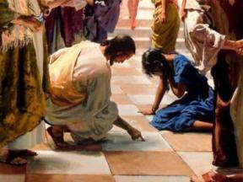
IMITATING JESUS in perfect Charity:
“A new command I give you: Love one another.
As I have loved you, so you must love one another.”
“By this everyone will know that you are my disciples, if you love one another.”
John 13:34-35
Jesus and the Woman Accused of Adultery

Slide 20
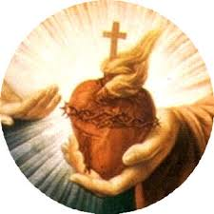
TAKE AWAY
Without love for our sisters and brothers, we will have failed as spiritual leaders even if we look successful.
Love changes everything, determines what we do with our day and all our choices and decisions.
It is through the eyes of love that we see Jesus in every member of the OFS, even when they are being difficult.
Sometimes we must care first about the person before enforcing the rules and regulations, praying for wisdom. (Do you agree or disagree?) Think: Woman caught in adultery.

Slide 21
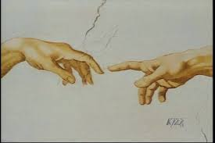
Wisdom: Trait 5 of a Franciscan Spiritual Leader
True Wisdom comes from the touch of God.
Most High, Glorious God!
Help me to make good and wise judgments based on prayer and the leading of the Holy Spirit

Slide 22
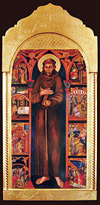
FOLLOWING FRANCIS in Wisdom
And after the Lord gave me some brothers, no one showed me what I had to do, but the Most High Himself revealed to me that I should live according to the pattern of the Holy Gospel.
Testament 14

Slide 23
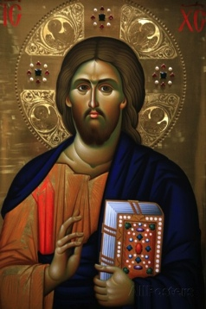
BELIEVING the Promise of CHRIST
And Jesus said, “I have told you this while I am with you.
The Advocate, the Holy Spirit that the Father will send in my name—he will teach you everything and remind you of all that [I] told you.”
^{John 14:25}

Slide 24
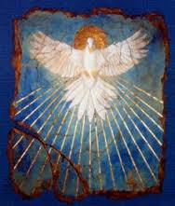
WISDOM TAKE AWAY
Wisdom allows us to make wise use of our time.
Trivia can hold a leader hostage and waste energy.
St. Francis and Jesus understood that wisdom is obtained in a balanced life of prayer and action – engagement and withdrawal.
Wisdom is based on truth; not on knowledge [although knowledge plays a part in wisdom]. Wisdom is a virtue that comes from God and should be sought in prayer.

Slide 25
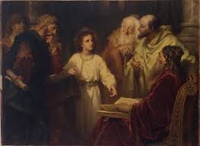
Understanding: Trait 6 of a Franciscan Spiritual Leader
Most High, Glorious God!
Jesus goes AWOL in the Temple
Luke 2:39-53
Help me to be patient with what is unfinished in myself and in others.

Slide 26
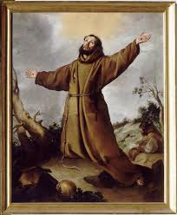
Following What FRANCIS Understood
Lord, make me an instrument of your peace.
Where there is patience and humility, there is neither anger nor disturbance.”
Saint Francis of Assisi
The Admonitions XXVII:
Virtue puts vice to flight.

Slide 27
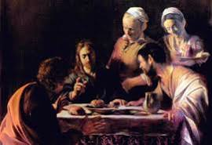
JESUS IMPARTS UNDERSTANDING
SCENE FROM EMMAUS
Jesus, speaks to his discouraged companion on the road, calling them “foolish” and “slow of heart” not to have understood what the prophets foretold. Beginning with Moses, Jesus interprets the Scriptures about him for them.
(We know the end of this story, but they don’t.) His companions beg him to stay and eat with them. And in the blessing and breaking of the bread, they recognized Him, whereupon Jesus disappears. Understanding dawns, and they return to Jerusalem.
Luke 24:25-32

Slide 28
TAKE AWAY
Understanding is the best use of spiritual knowledge.
It comes from exercising the virtues such as patience and humility.
It is the ability to discern the truth in making choices and decisions.
Along with wisdom, understanding should be sought in prayer.
666

Slide 29
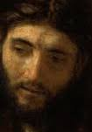
Carrying Out God’s Will: Trait 7 of a Franciscan Spiritual Leader
Most High, glorious God,
Stay by my side Lord so that my devotion and service to you will never waver.
7

Slide 30
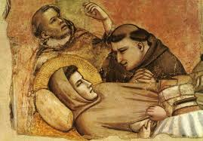
FOLLOWING FRANCIS
[carrying out God’s holy and true command]
Therefore, let us desire nothing else,
let us want nothing else,
let nothing else please us and cause us delight except our
Creator,
Redeemer and
Savior,
the only true God,
Who is the fullness of good, all good, every good, the true and supreme good.

Slide 31
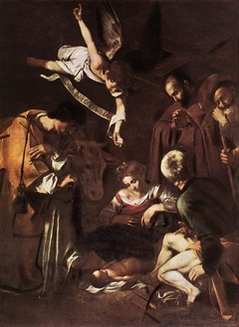
CHRIST Fulfills God’s Will Part 1
The Incarnation:
And the Word became flesh and made his dwelling among us, and we saw his glory, the glory as of the Father’s only Son, full of grace and truth.
John testified to him and cried out, saying, “This was he of whom I said, ‘The one who is coming after me ranks ahead of me because he existed before me.’” …
No one has ever seen God. Only the Son, who is at the Father’s side, has revealed him.
John 1:14-15

Slide 32
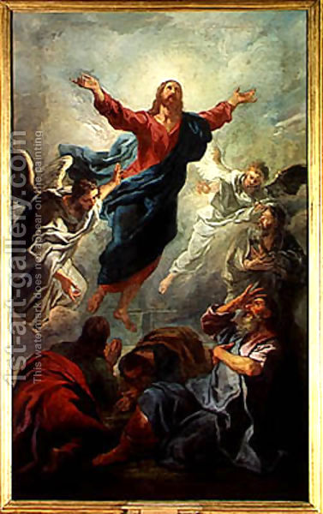
CHRIST Fulfilling God’s Will Part 2
Commissioning of the Disciples:
The eleven disciples went to Galilee, to the mountain to which Jesus had ordered them. When they saw him, they worshiped, but they doubted. Then Jesus approached and said to them, “All power in heaven and on earth has been given to me. Go, therefore,* and make disciples of all nations, baptizing them in the name of the Father, and of the Son, and of the Holy Spirit, teaching them to observe all that I have commanded you. And behold, I am with you always, until the end of the age.”
Matthew 28:16–20
Priestly rayer John 17

Slide 33
TAKE AWAY
Listening in prayer is key to discerning God’s will, and Scripture will support God’s will.
Seek guidance from others: spiritual assistants, a personal spiritual director, members of the council, former leaders, etc.
Seek guidance through OFS documents.
Be aware of our gifts AND our limitations—through soul-searching.
Seek God’s will in opportunities and circumstances; in needs and desires.

Slide 34
The Essence of Franciscan Spiritual Leadership
So What Must a Leader Do?
Above all, love your people, especially when their actions toward you are unlovable (not to be confused with being a doormat)
Be willing to take risks and develop a thicker skin (see #1)
Commit to working tirelessly, at times without tangible gratitude or reward
Be a servant leader—Be Jesus to those you serve.

Slide 35
The Essence of Franciscan Spiritual Leadership
So What Does a Leader Need?
Relational Components (External)
Restorative Prayer
Supportive Relationships
Respect for and Trust in Others

Slide 36
The Essence of Franciscan Spiritual Leadership
More Needs
Internal Components
Joy which Resists Discouragement
Character, Courage, and a Plan (Vision)
Focus and Passion

Slide 37
Discussion Questions
Question 1:
Describe the key actions and behaviors of persons that you have experienced as your best leaders.
a. Can you name a person who has had a tremendous impact on you as a person leading others? Why and how did this person impact your life?

Slide 38
Discussion Questions
Questions 2 and 3
(2) From your experience in leadership, what advice would you give someone being elected for the first time?
(3) What is the biggest challenge facing you today as a leader?

Slide 39
Discussion Questions
Question 4
How do you interpret the statement “Leadership is relationship?”
a. How do you encourage others in your region to communicate?

Slide 40
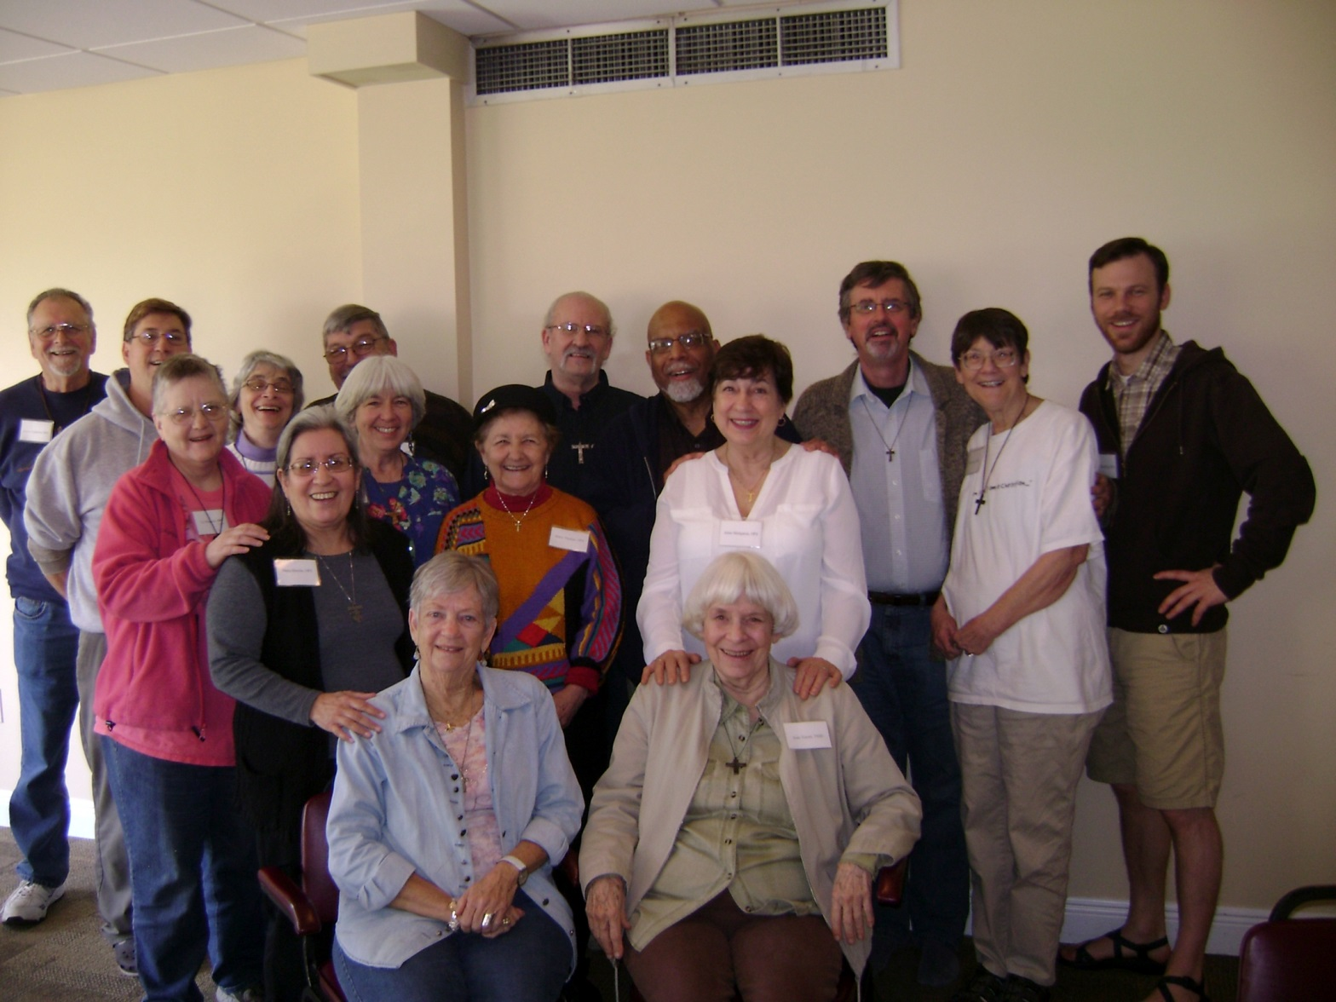
This slide has nothing to do with my presentation
But
you
must
admit
they
are leaders!

